Slide 1


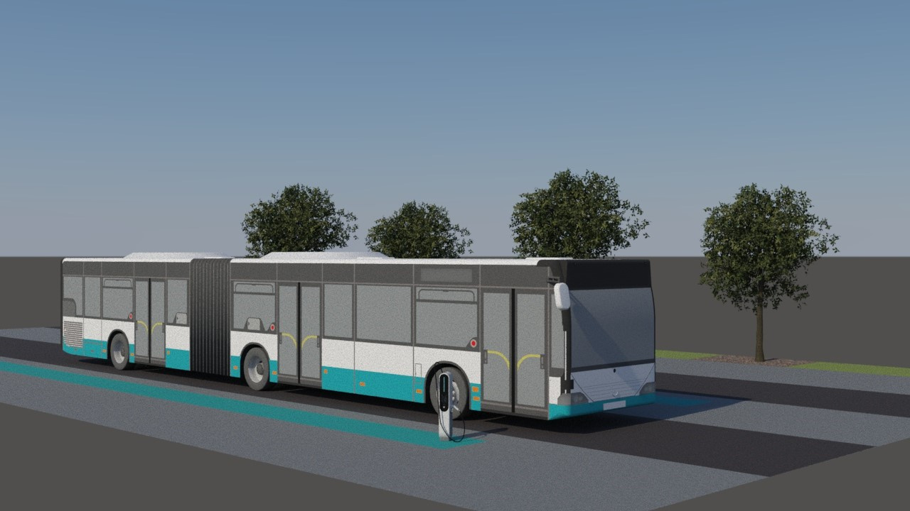
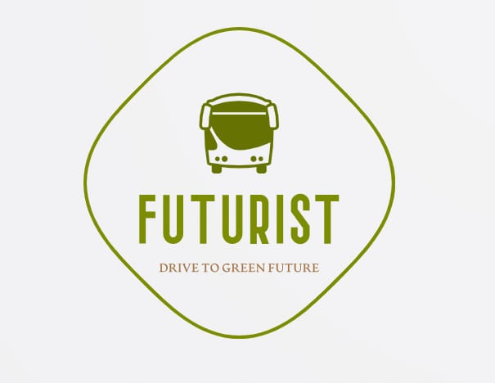

Faculty of Engineering and Natural Science
FENS401 PROJECT
FuturIst
Drive to Green Future
20181701040 - Buket Nalbantoğlu
20181704073 - Eda Ezgi Koçan
20191704006 - Salih Aladdin Sarıhan
20191704009 - Berke Turan
20191704010 - Dilan Demirörs
20191701011 - Kazım Emre Yılmazcan
20191701013 - Aleyna Söylemez

Slide 2
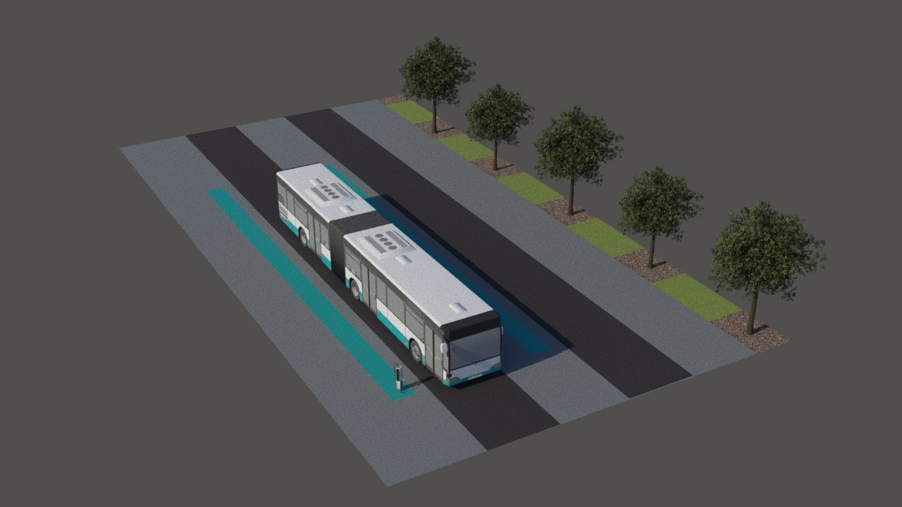
Content
01
INTRODUCTION
The Energy Sources in the World
Current Global Problem
Motivation
Objective of the Project
Case Studies
Novelty of Project
02
DESIGN AND SOLUTION
Area Planning
Solar Panel Design
Impact
03
PROJECT MANAGMENT
Project Budget
Risk Analysis
Gantt Chart
Radar Charts
04
CONCLUSION
05
FUTURE WORKS
06
REFERENCES

Slide 3

INTRODUCTION

Slide 4

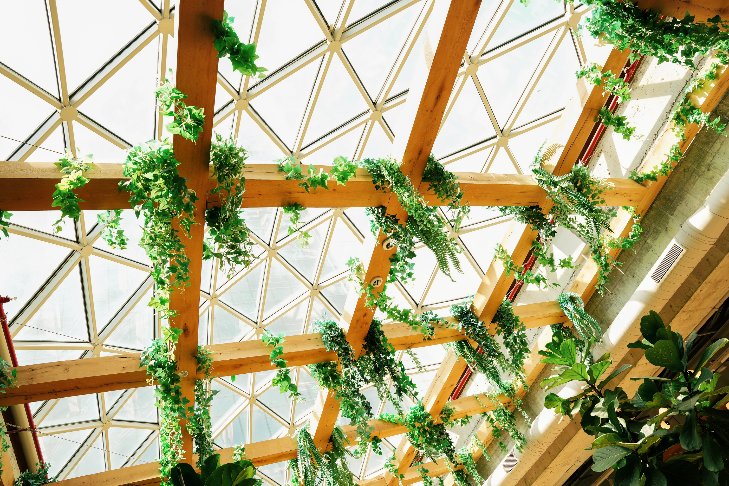
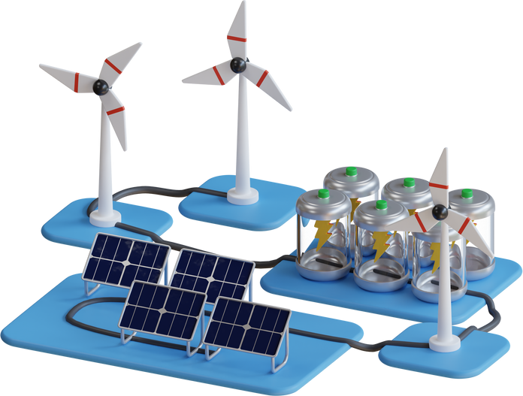

ENERGY SOURCES IN THE WORLD
Renewable
Non-Renewable
Solar Energy
Wind
Hydroelectricity
Bioenergy
Coal
Oil
Natural Gas
Nuclear Energy
ENERGY SOURCES IN THE WORLD

Slide 5
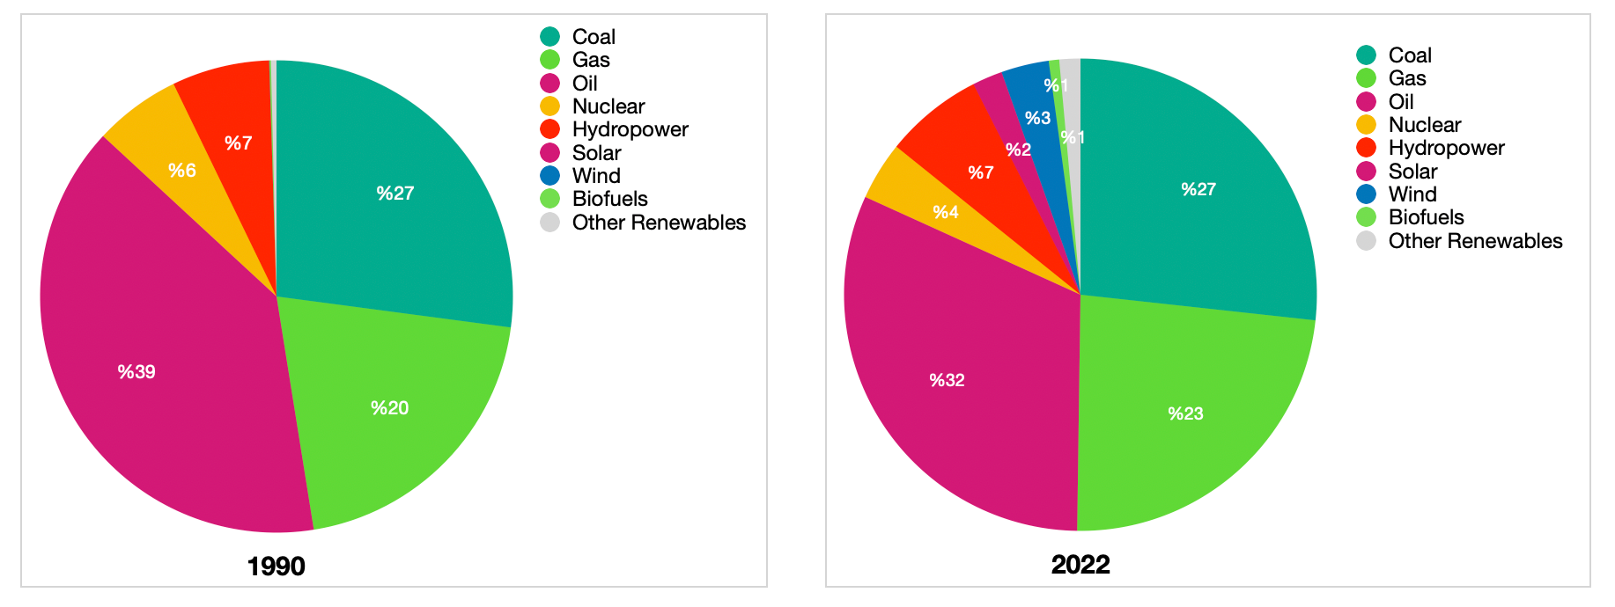
ENERGY SOURCES IN THE WORLD
Annual gross world energy consumption - 1990
Annual gross world energy consumption - 2022

Slide 6

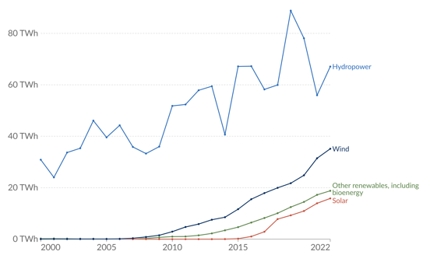
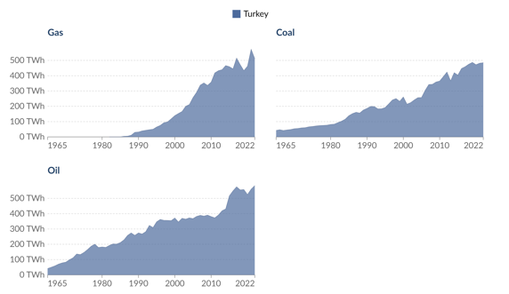
ENERGY SOURCES IN THE WORLD
Modern renewable energy generation by source, Turkey
Fossil fuel consumption by fuel type, Turkey

Slide 7
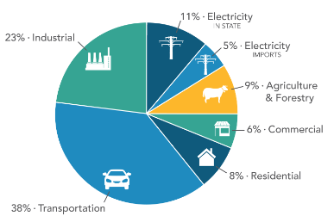
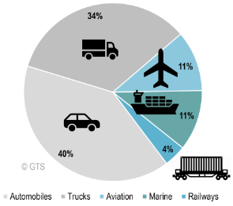
Current Global Problem
“Urban transportation is a major contributor to CO2 emissions ”
CO2 Emissions by the Economic Sector
CO2 Emissions by the Transport Sector

Slide 8

25%
Global greenhouse gas emissions
Transitioning to a solar-powered, sustainable transportation system is crucial for mitigating climate change by eliminating fossil fuel emissions

Slide 9
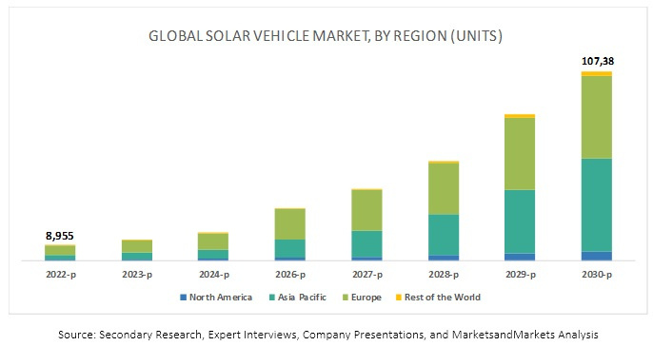
Analysis
The solar vehicle industry is on a steady rise from 2022 to 2030.

Slide 10
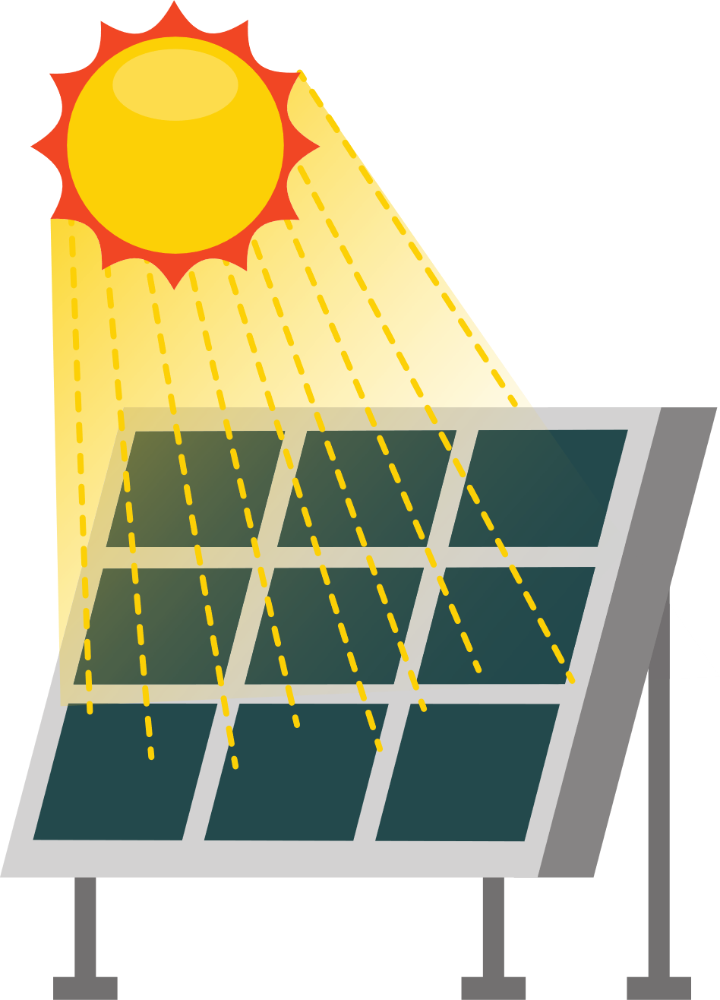
Novelty of the Project
Our project introduces solar-powered Metrobuses on the Söğütlüçeşme-Pendik route, strategically chosen for high population densities and transportation issues.

Slide 11
DESIGN AND SOLUTION

Slide 12

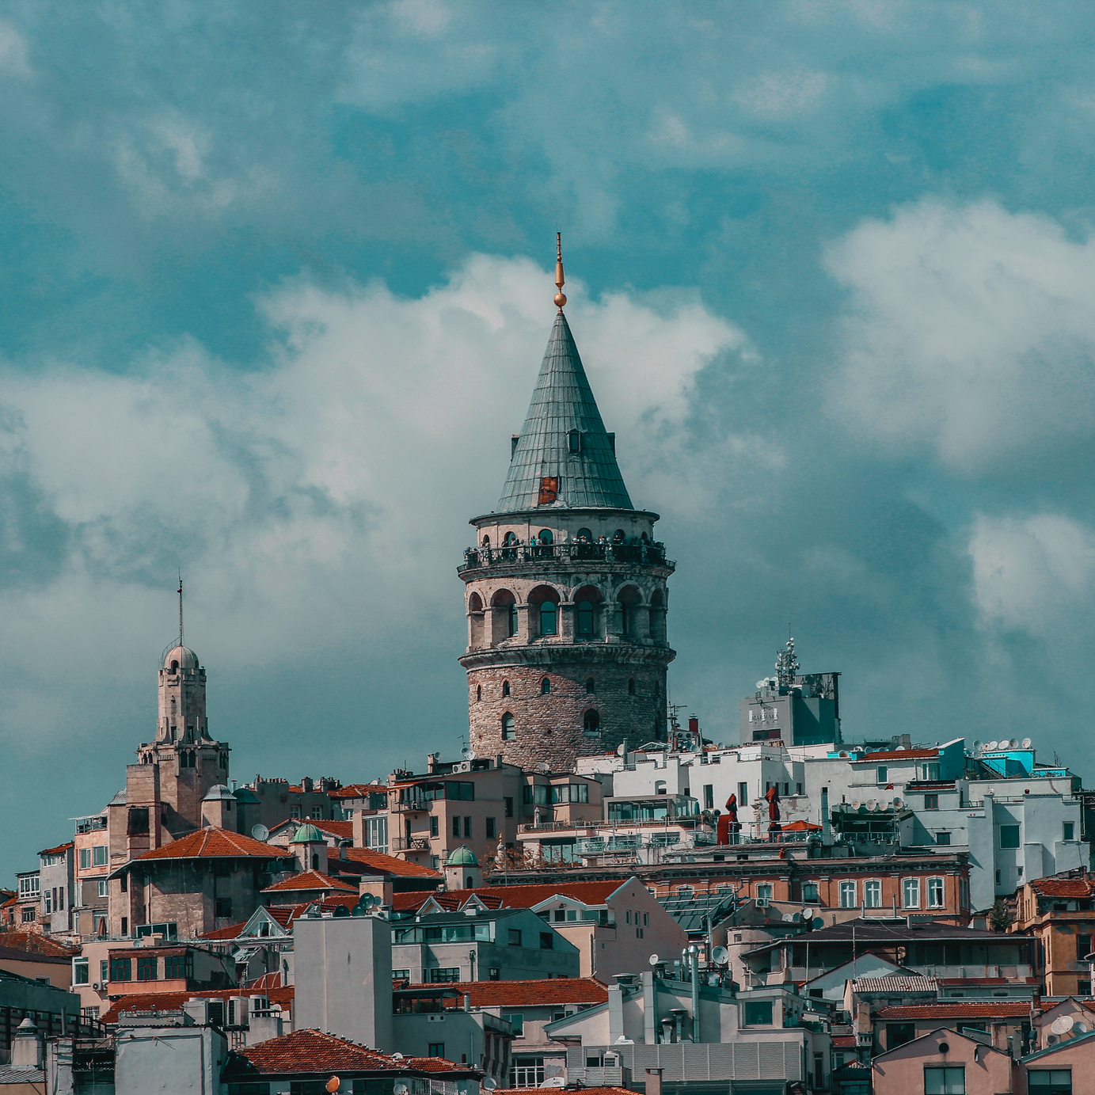
Area Planning
Factors that Affected Area Planning
•Population distribution of Istanbul
•Weather Condition distribution of Istanbul
•Average Air temperature distribution of Istanbul

Slide 13


Population Distribution
Crowded Districts
Less Crowded Districts
Pendik
Maltepe
Üsküdar
Küçükçekmece
Kadıköy
Beşiktaş
Beykoz
Sarıyer
Beyoğlu

Slide 14
Weather Condition Distribution of Istanbul
•Good weather conditions occur most frequently
•Bad weather conditions occur most frequently
• Winter
• Beykoz, Sarıyer and Pendik
• Spring
• Beykoz,Pendik and Beylikdüzü
• Summer
• Beykoz, Üsküdar and Ataşehir
• Autumn
• Beykoz, Üsküdar and Beşiktaş
• Winter
• Kadıköy,Maltepe and Beşiktaş
• Spring
• Kadıköy, Maltepe and Ataşehir
• Summer
• Avcılar, Beşiktaş andBeylikdüzü
• Autumn
• Avcılar, Ataşehir and Sarıyer

Slide 15
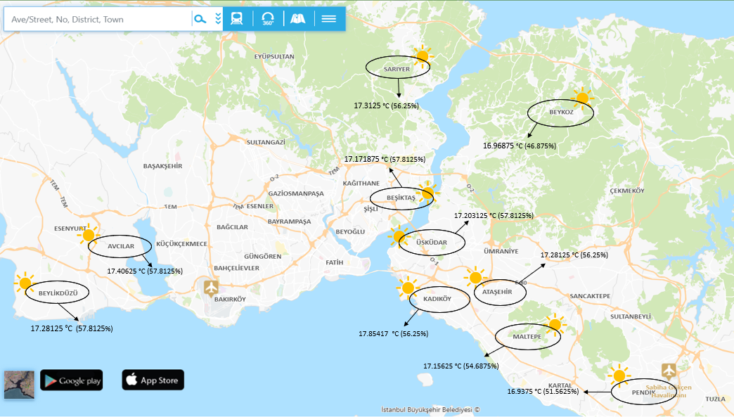
Average Daytime Air Temperature

Slide 16
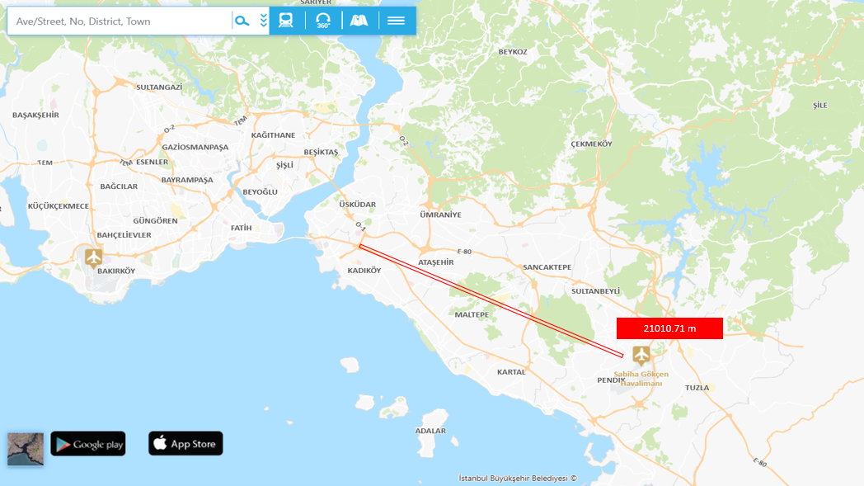
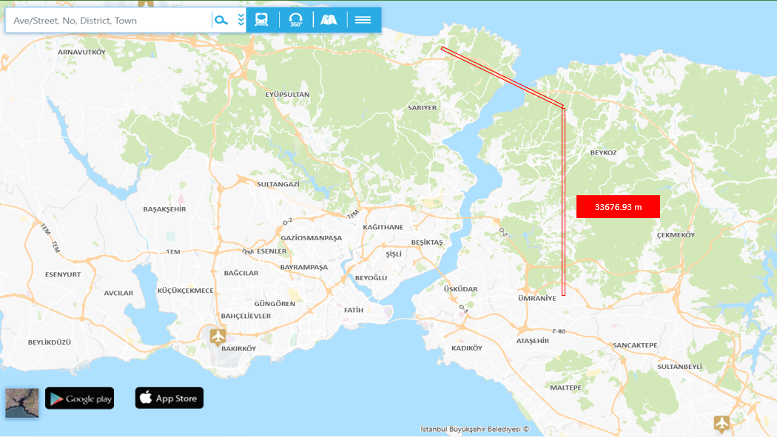
Candidate Routes
Söğütlüçeşme-Pendik
Sarıyer-Ümraniye

Slide 17

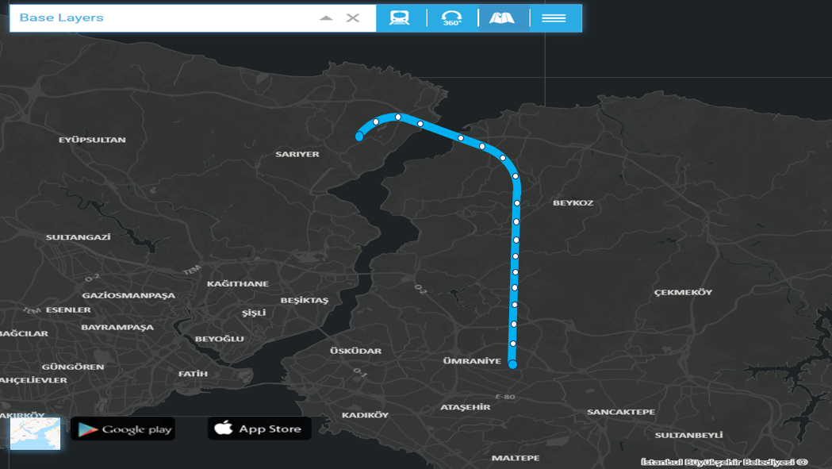
Sarıyer-Ümraniye Route
33.6 km – 440k sqm
18 Stations
5 Main Stations

Slide 18
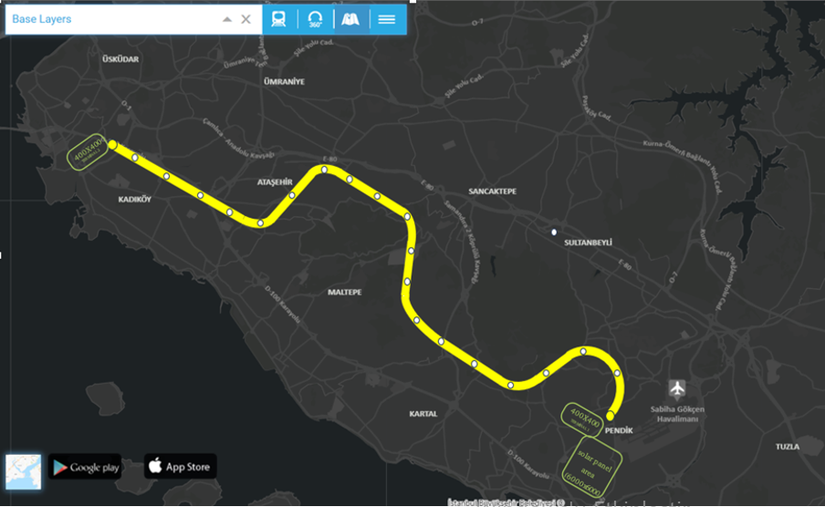
Söğütlüçeşme-Pendik
•21 km – 274k sqm
•21 Stations
•2 Main Stations (4 starting points)

Slide 19
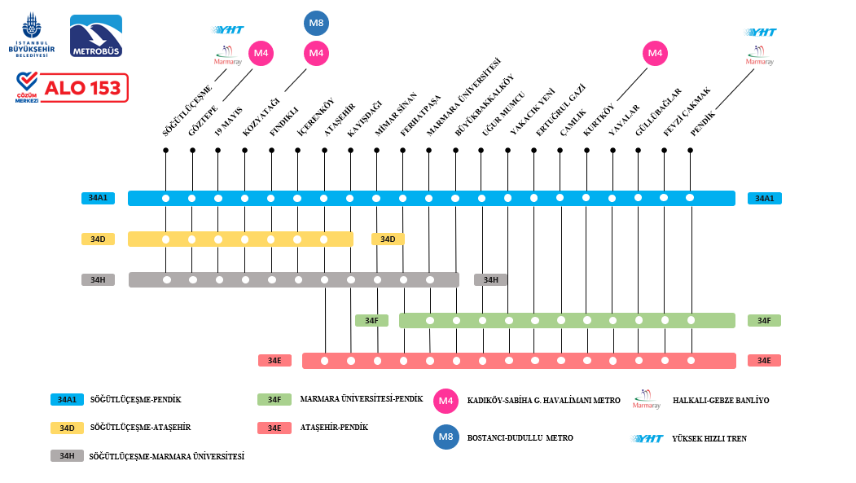
Route Selection and Stations Map

Slide 20
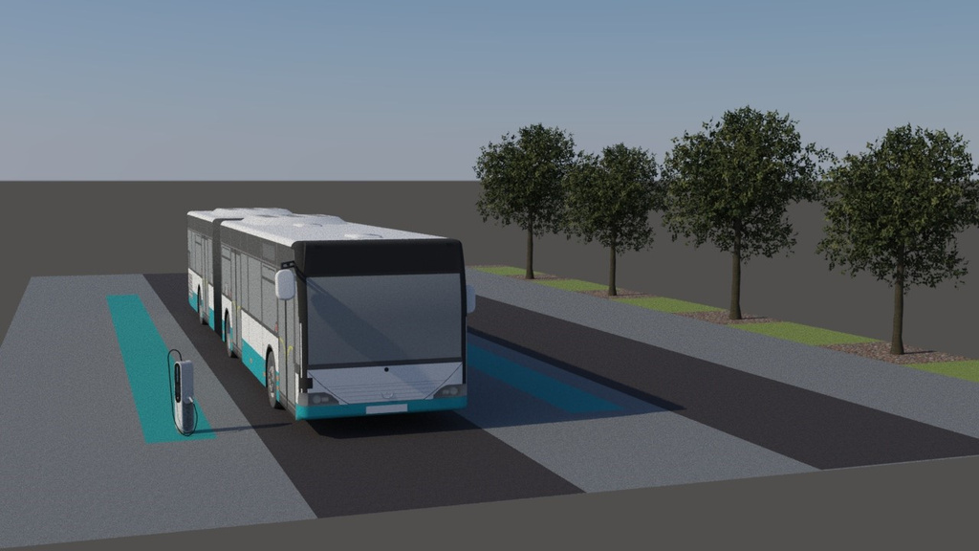

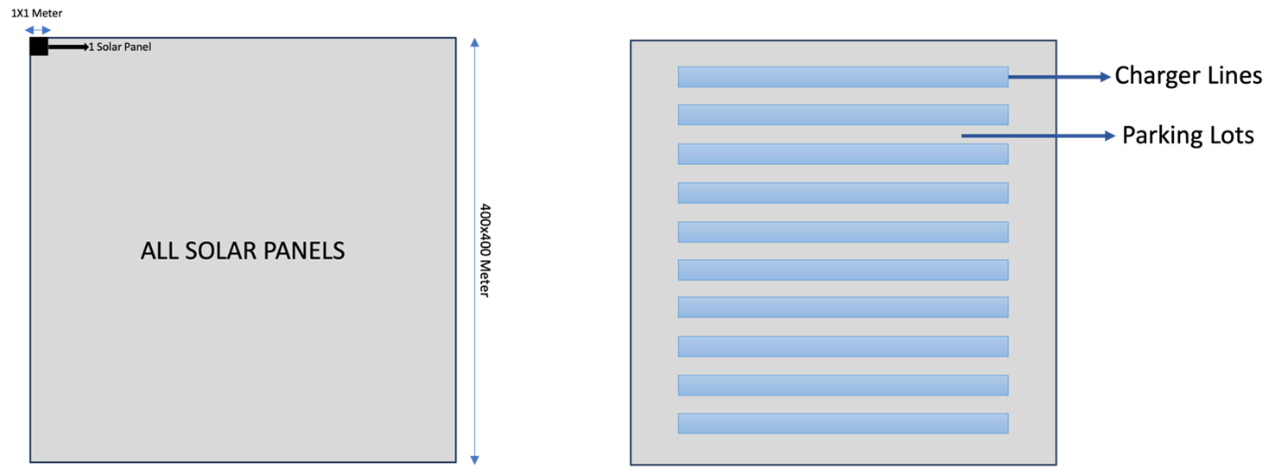
Charging Area and Metrobus Location

Slide 21
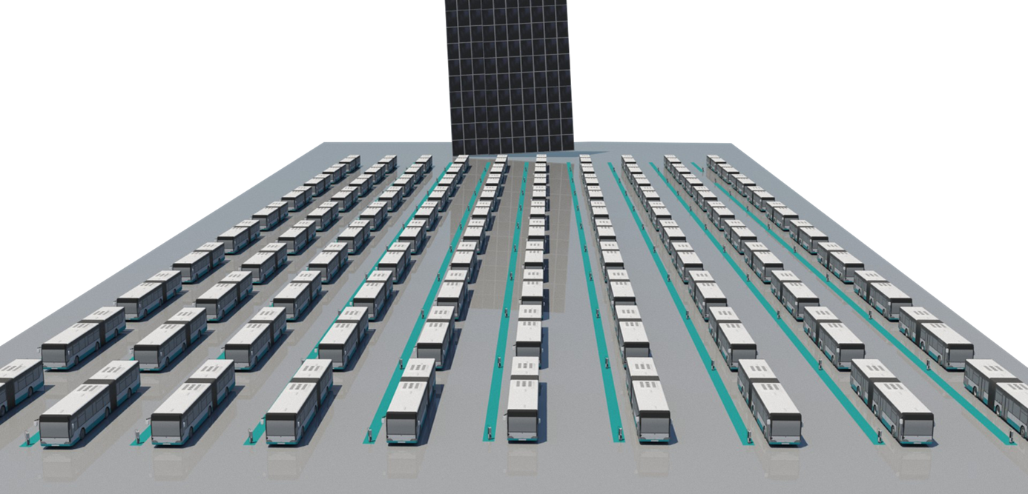
Layout
for
Söğütlüçeşme

Slide 22
Solar Panel Design
For a standalone system for Metrobus
Solar Panels
Batteries
Charge Controller
Inverter

Slide 23

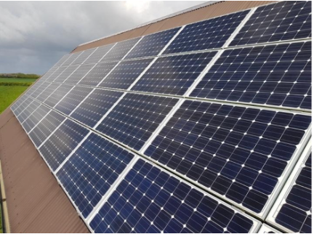
SOLAR PANELS
Solar panels convert sunlight
into electrical energy.
01
Solar Panel Criteria
02
Solar Panel Needs
Monocrystalline Solar Panel

Slide 24

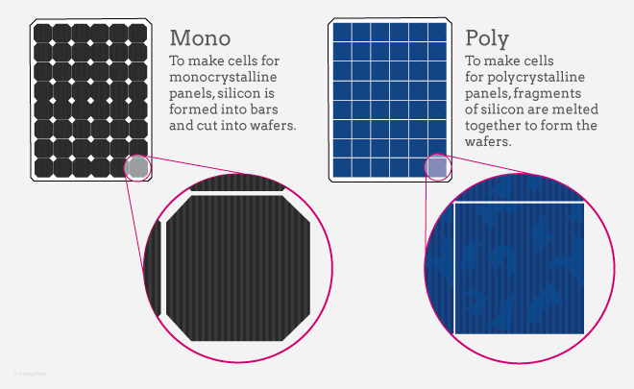
SOLAR PANEL CRITERIA
Durability
Weight
Lifespan
Maintenance
Efficiency
Cost

Slide 25
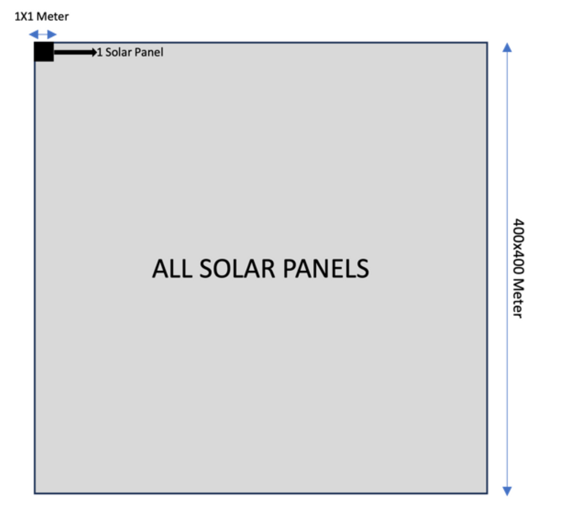
SOLAR PANEL NEEDS
9600 kwatt energy in total
In 6 hours of sunny time per day
1 square meter panel can produce 1.5 kwatt per day
9600 / 1.5 = 6400 pieces required

Slide 26
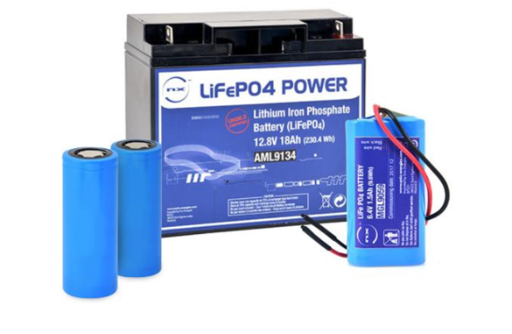
BATTERIES
Storage of converted solar energy
using batteries.
01
Battery Criteria
02
Lithium Iron Phosphate (LiFePO4) batteries
Battery Needs

Slide 27
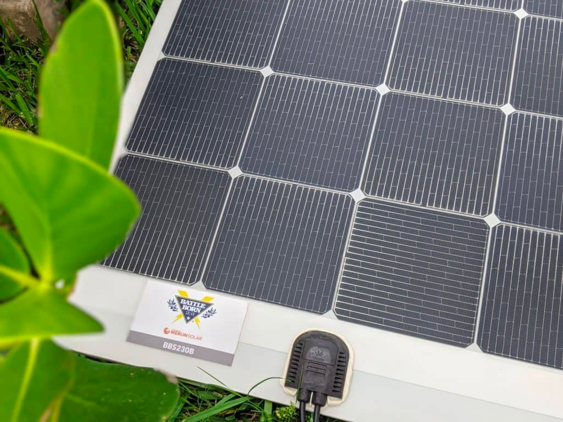

BATTERY CRITERIA
Weight
Durability
Maintenance
Lifespan
Efficiency
Safety
Cost

Slide 28
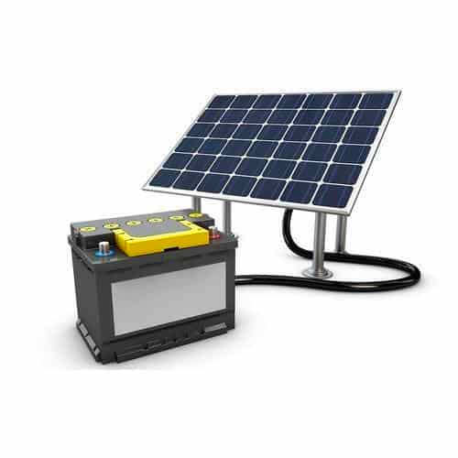
BATTERY NEEDS
We need 2700 kwatt of energy we need
LiFePO4 can store 4.8 kwatt of energy.
2700/4.8 = 563 batteries
In case of mishap, we also bought 12 spare batteries
So 575 batteries in total

Slide 29
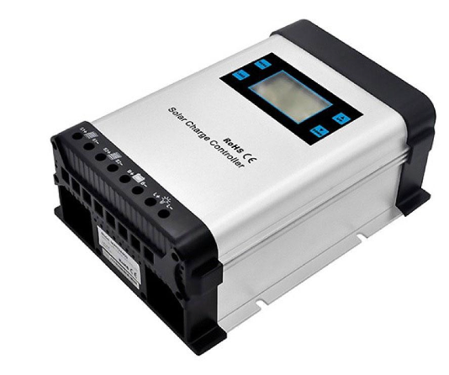
CHARGE CONTROLLER
The charge controller charges the energy from the solar panel to the battery.
01
Charge Controller Criteria
02
Charge Controller Needs
MPPT

Slide 30

Charge Controller Criteria
Charge Controller Needs
High Efficiency
575 Charge Controller
One can handle minimum of 4kW energy transfer
Versatility
Temperature Compensation
Optimal Charging for LiFePO4

Slide 31
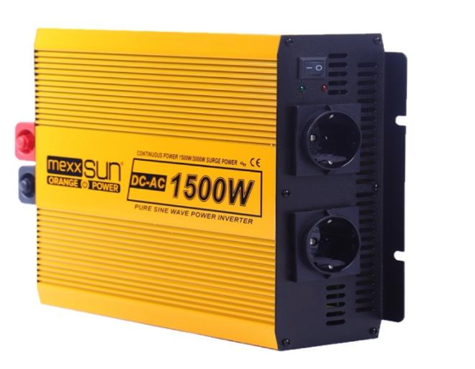
INVERTER
Inverters convert the direct current to
alternating current.
01
Inverter Criteria
02
Inverter Needs
Pure Sine Wave Inverter

Slide 32
Inverter Criteria
Inverter Needs
Clean and Stable Power
Compability With Electronics
600 units Pure Sine
Wave Inverters
One device can handle 6 kwatt
59 were taken as spares
Reduced Heat Generation
Versatility
Compability With LiFeP04

Slide 33

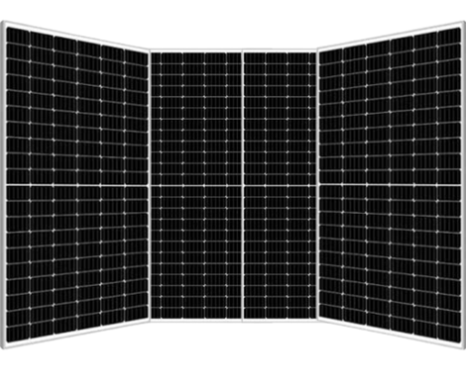
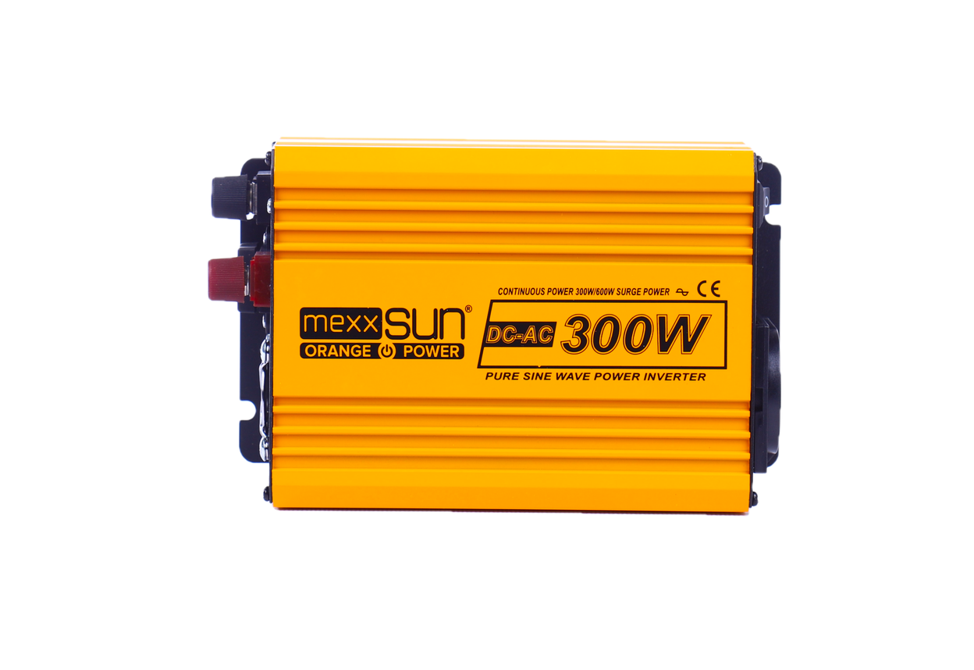
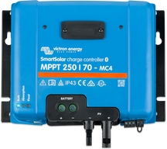
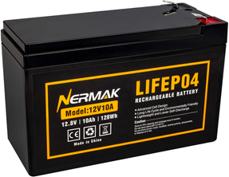
DESIGN
Pure Sine Wave Inverter
Designed FurutIST using Monocrystalline Solar Panels, Lithium Iron Phosphate (LiFePO4) batteries, MPPTs, and Pure Sine Wave Inverters.
Monocrystalline Solar Panels
MPPT
FuturIST Metrobus
LiFePO4 Battery Banks

Slide 34
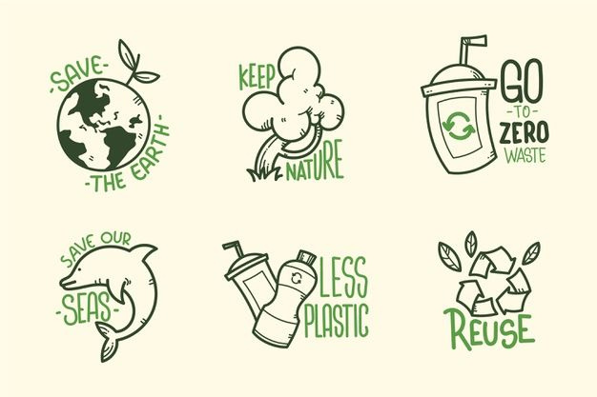

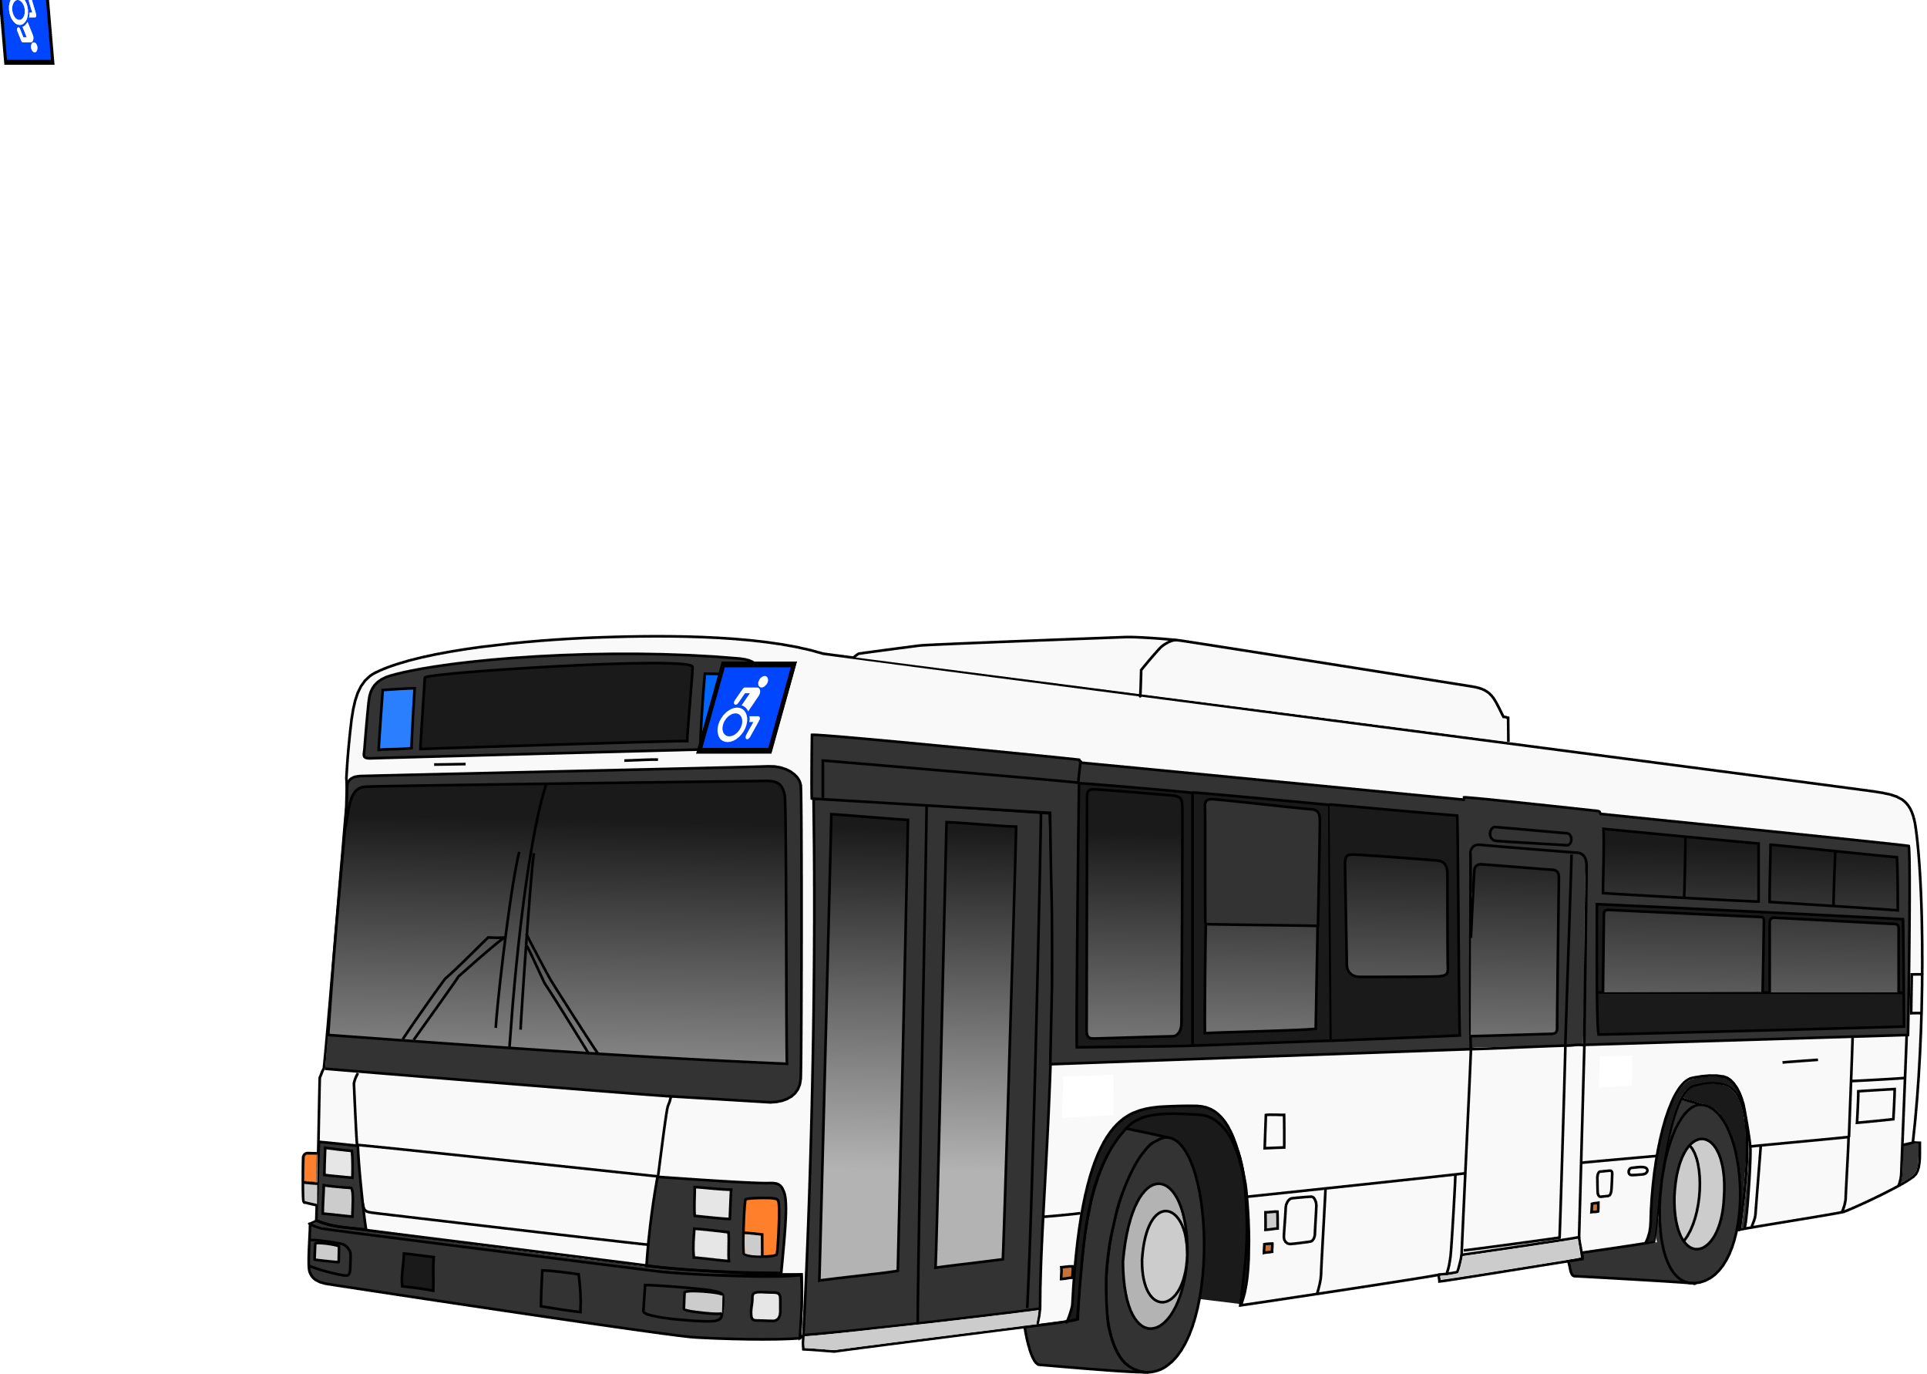

1)Enviromental Impact
2)Economic Impact
Environmentally friendly
Positive impact on climate change
Improves air quality
Noise and visual pollution reduction
FuturIST
Impact
Increase in Local Employment
Contribution to Economic Growth
Reduction of Energy Imports
Strengthening Energy Independence
3)Social Impact
Accessibility and social contribution
Reduction in health problems
Reducing the unemployment problem

Slide 35
PROJECT MANAGEMENT

Slide 36
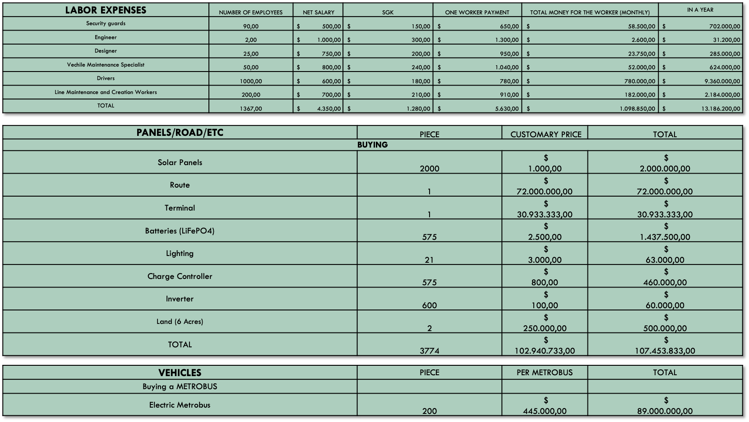
EXPENSES

Slide 37
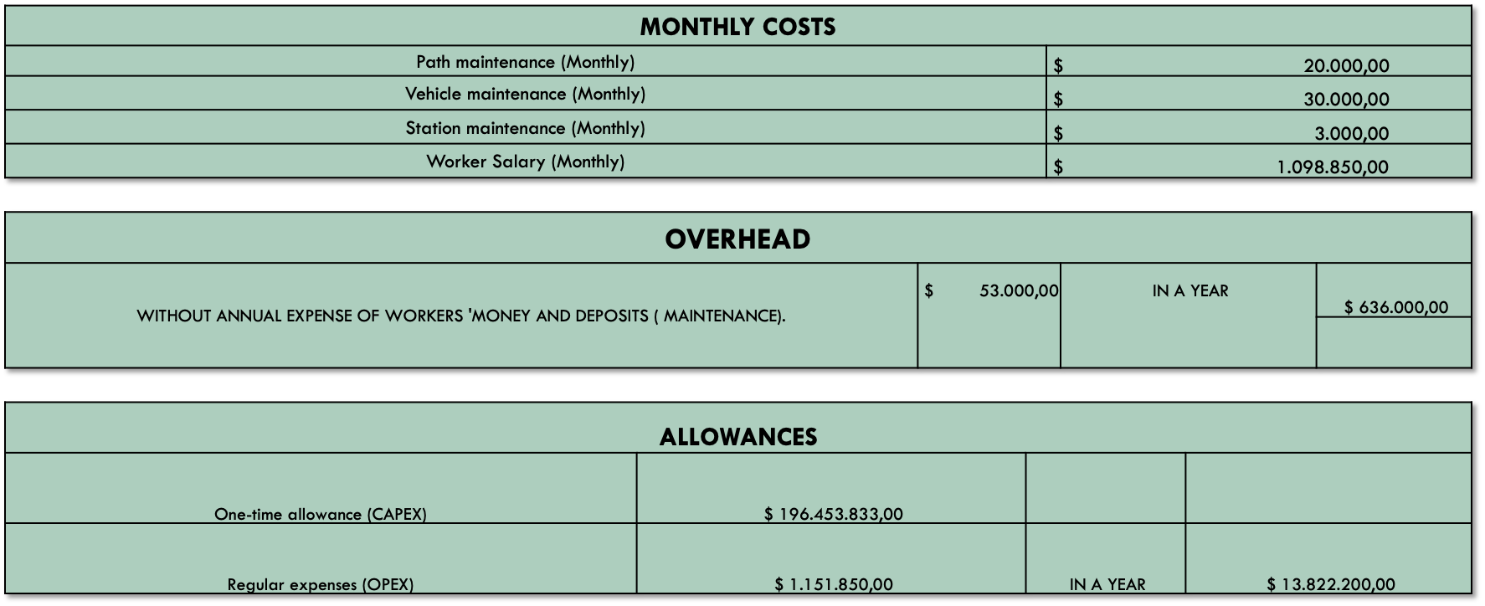
OVERHEADS

Slide 38
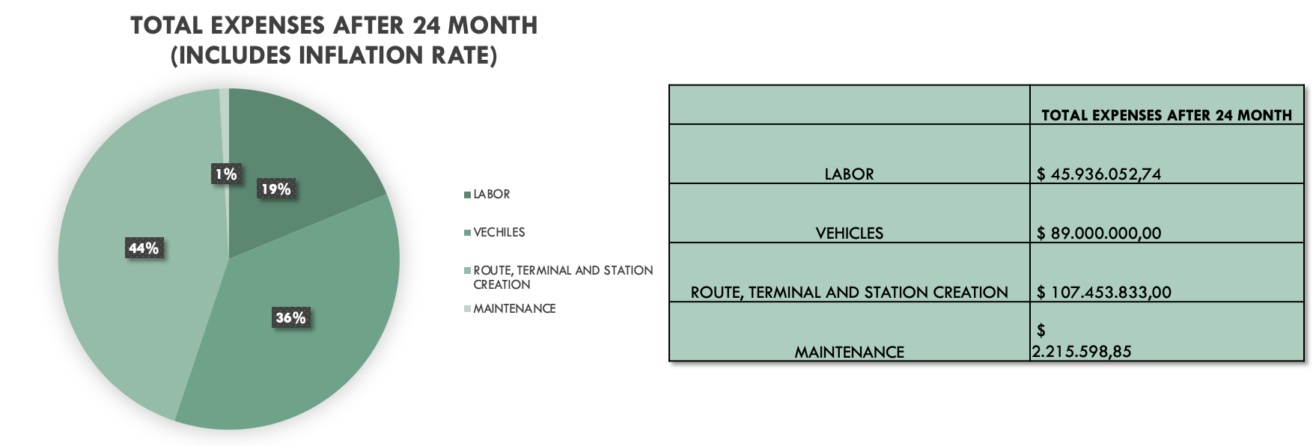

Slide 39

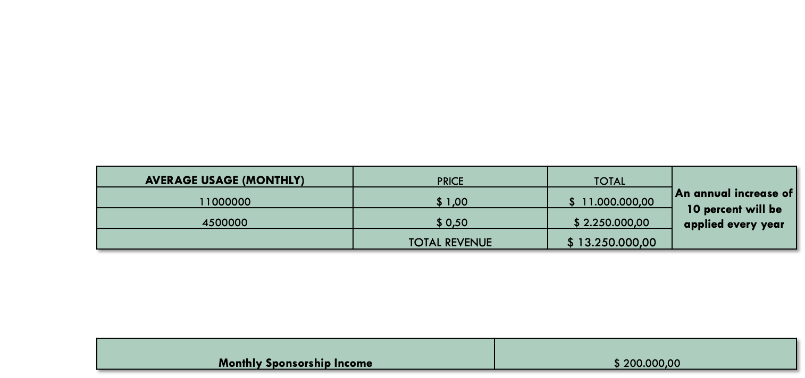
SOURCES OF INCOME
TICKET INCOME
SPONSORSHIP

Slide 40
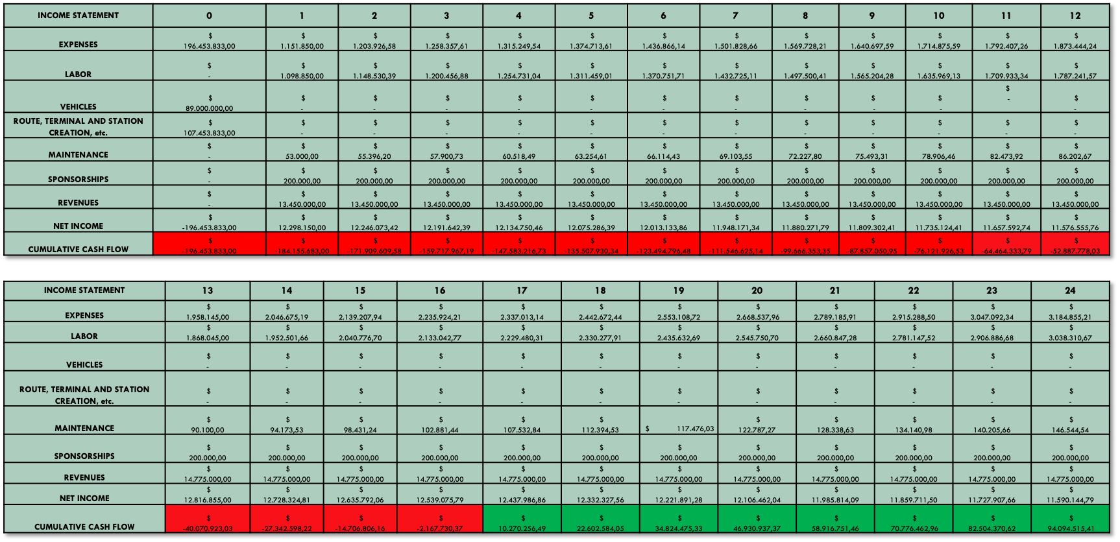
CASH FLOWS

Slide 41
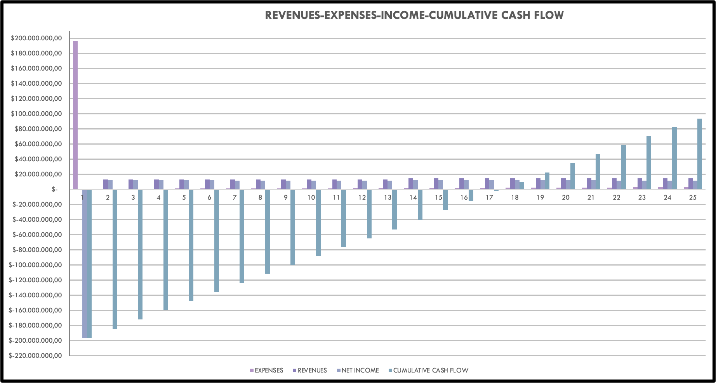

Slide 42

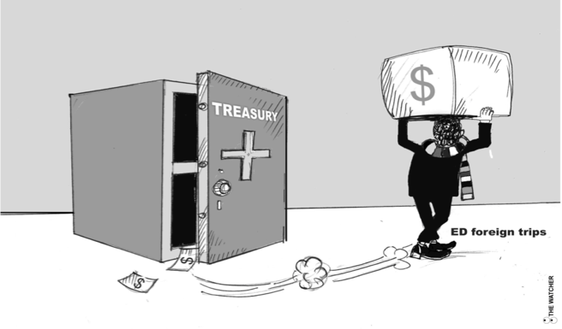

FINANCING OPTIONS
1)Municipal Treasury

Slide 43
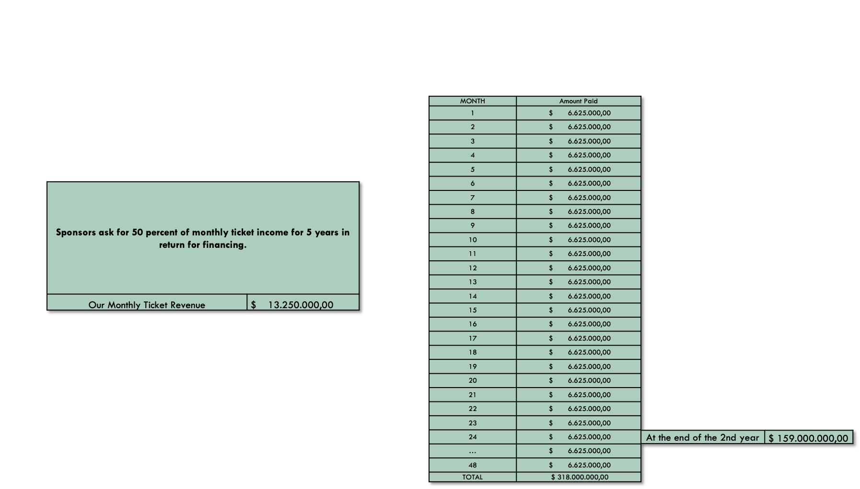
FINANCING OPTIONS
2)SPONSORSHIP

Slide 44
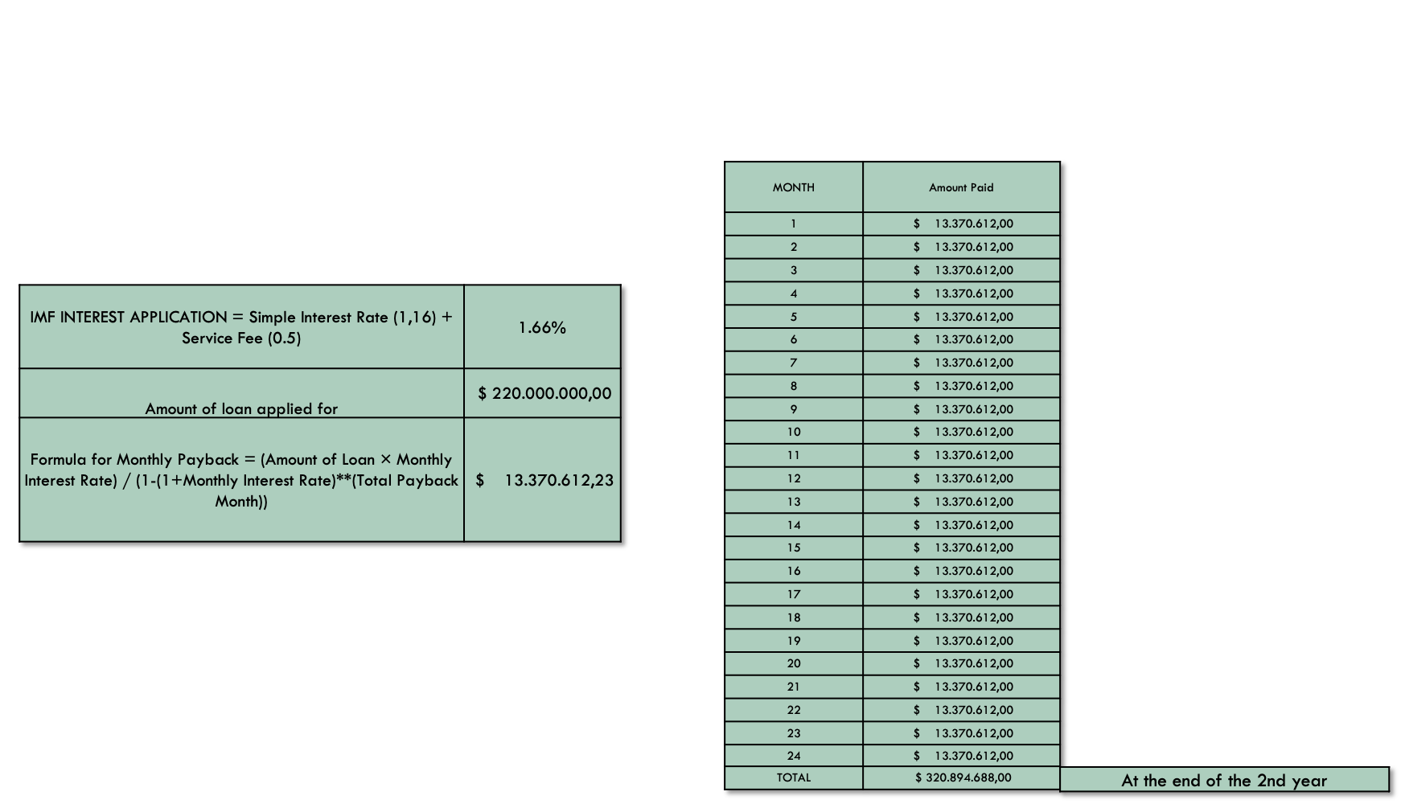
FINANCING OPTIONS
3)IMF LOAN

Slide 45
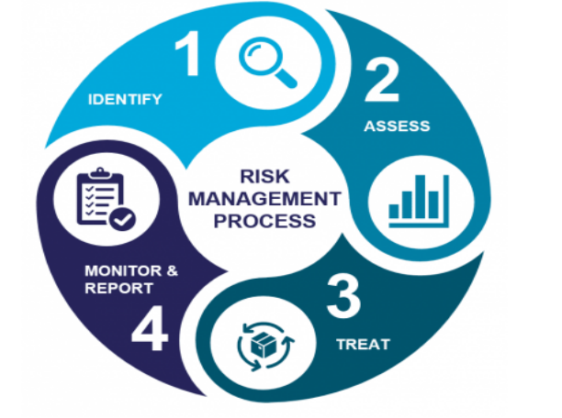
RISK ANALYSIS
Remy
Marsh
Everest Cantu
Drew Holloway
Morgan Maxwell
Manager
Marketing
Business Head
Manager

Slide 46
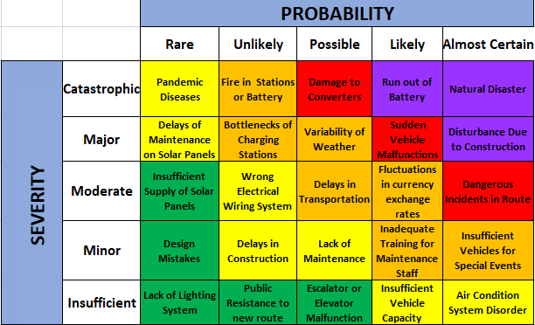
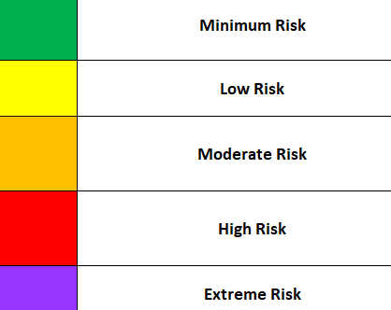
RISK ASSESSMENT TABLE
Remy
Marsh
Everest Cantu
Drew Holloway
Morgan Maxwell
Manager
Marketing
Business Head
Manager

Slide 47
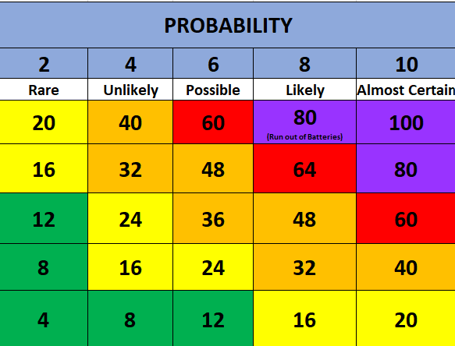
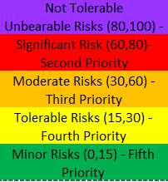

RISK RATING TABLE
Remy
Marsh
Everest Cantu
Drew Holloway
Morgan Maxwell
Manager
Marketing
Business Head
Manager

Slide 48



RISK MITIGATIONS
Emergency plans
Personnel training
Logistics support team
Infrastructure strengthening
Extreme Risk
Natural Disaster
Regular maintenance programs
Monitoring and optimizing energy use
Long-lasting, high-capacity batteries
Extreme Risk
Run out of Battery
Determining alternative routes (for use)
Communicating with local people
Organizing regular meetings with the public
Extreme Risk
Disturbance Due to Construction

Slide 49



RISK MITIGATIONS
High Risk
Use of high quality materials
Regular maintenance program
Rapid intervention plans
Damage to Converters
High Risk
Extra vehicle availability
Vehicle tracking system
Regular maintenance
Spare parts stock control
Sudden Vehicle
Malfunctions
High Risk
Advanced security systems
Regular security training
Communication protocols
Dangerous Incidents in Route

Slide 50

GANTT CHART
Project Initiation Tasks

Slide 51


GANTT CHART
Planning and Design Task

Slide 52


GANTT CHART
Execution Tasks

Slide 53

GANTT CHART
Evaluation Tasks

Slide 54

GANTT CHART
Project Close Tasks

Slide 55

Gantt Chart of Our Project

Slide 56


First Complexity Map
RADAR CHARTS

Slide 57


RADAR CHARTS
Second Complexity Map

Slide 58


RADAR CHARTS
Third Complexity Map

Slide 59

CONCLUSION
Designed a solar-powered Metrobus in Istanbul
The Metrobus operates between Söğütlüçeşme and Pendik
Power is produced in a standalone solar panel system
The project is planned as it could finance itself in 2-year projection
Aims to reduce CO2 emission and contribute to environmental, social, and economic development of Turkey

Slide 60





Future
Works
01
Increase in solar energy demand
02
Changing transportation trends
03
Traffic problems will decrease
04
It will support development

Slide 61
REFERENCES
Global primary energy consumption by source. (n.d.). Our World in Data. https://ourworldindata.org/grapher/global-energy-consumption-source?time=1992..latest
Eşkin, P. Ö. (n.d.). Dünya’nın ı̇ lk güneş enerjisi ı̇ le çalışan treni | Ekolojist.net. Ekolojist.net. https://ekolojist.net/dunyanin-ilk-gunes-enerjisi-ile-calisan-treni/#
Nandi, T. (2017, July 14). Indian Railways launches first solar-powered diesel electrical multiple unit train. The Economic Times. https://economictimes.indiatimes.com/industry/transportation/railways/indias-first-solar- power-train-launched/articleshow/59592199.cms
CleanTechnica. (2016, July 21). Adelaide creates world’s first solar-powered public transport system. RenewEconomy. https://reneweconomy.com.au/adelaide-creates-worlds- first-solar-powered-public-transport-system-32530/
Sono Motors. (2022, November 17). Sono Motors and Pepper debut electric bus with solar technology. https://sonomotors.com/en/press/press-releases/sono-motors-and-pepper- debut-electric-bus-with-solar-technology/
William Cobb demonstrates first solar-powered car. (2010, January 27). HISTORY. https://www.history.com/this-day-in-history/william-cobb-demonstrates-first-solar-powered- car

Slide 62

THANK
YOU!

